Slide 1

Şaban Çepni/ 17058052
Mathematical Engineering Student
Social Media Application Using Firebase and Android Studio
Thesis Supervisor: Dr. Gökhan GÖKSU
WELCOME!

Slide 2
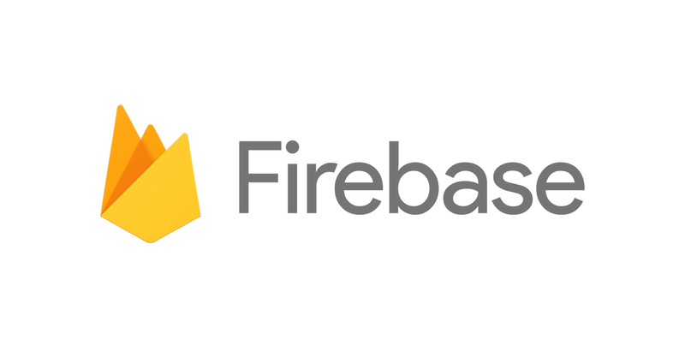
What is Firebase?
Firebase is a google’s mobile app development platform that has a huge toolset that contains lots of things for improving, scaling and creating your android application.
History of Firebase
Envolve, a previous firm established in 2011 by James Tamplin and Andrew Lee, gave rise to Firebase. Envolve was an API that enabled the integration of online chat functionality into websites. After releasing Envolve Tamplin and Lee found that it was being used to pass application data that were not chat messages. Developers were using Envolve to sync application data such as game state in real time across their users. Tamplin and Lee decided to separate the chat system and the real-time architecture that powered it. In 2011, they established Firebase as a distinct business.
NEXT

Slide 3
Why Firebase?
To make social media application for mobile you need many services such as authentication, cloud messaging, database and cloud storage. While there are so many options for all services individually. While doing a research i found firebase had all of the necessary services for making social media application not just that it had even more services than necessary.
NEXT

Slide 4
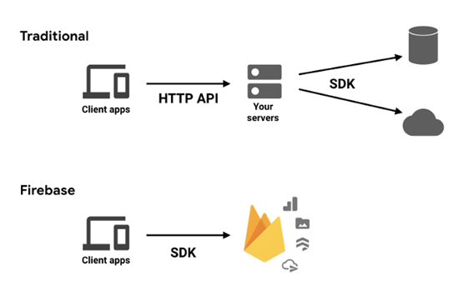
Benefits of Firebase
There isnt a fixed tool for authentication, cloud messaging, analytics, database and storage if you want to use you’ll pick the one that suits most in your case. When you want to focus on the app more instead of these tools Firebase is one of the most pickable one.
The Reasons For that Is:
Firebase uses the JavaScript Object Notation (JSON) format to store its data, which eliminates the need for queries when inserting, updating, deleting, or adding data. So you don't need to learn database when making your application and Firebase don't require any middleware between your app and the service because Firebase's client SDKs communicate directly with backend services.
NEXT

Slide 5
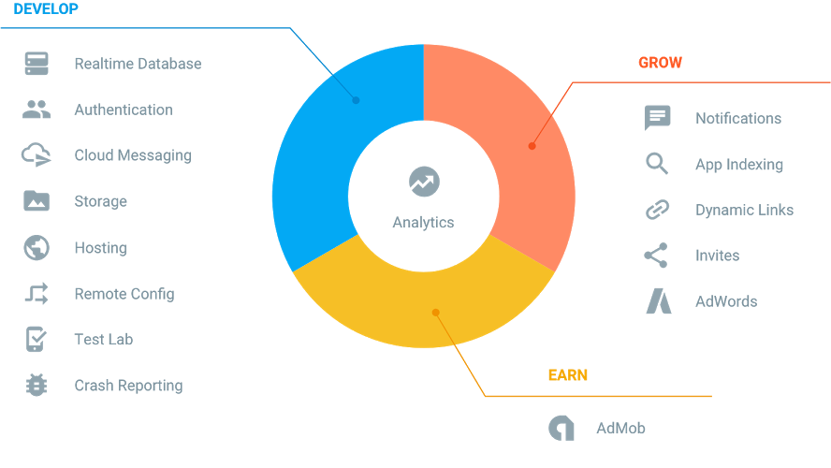
Firebase Features
Features That I Use:
Firebase Authentication
Firebase Storage
Firebase Database
Firebase Cloud Messaging
NEXT

Slide 6











Companies And Projects Using Firebase
Most Known Companies That Use Firebase Services
Twitch.tv
It employs Firebase services alongside its existing infrastructure to provide real-time data to its clients. It also utilizes Firebase authentication to provide security features on individual user accounts.
9GAG
9gag is the biggest meme community on the Internet. It ranks number one on the global entertainment and gaming charts. It employs the Firebase enterprise platform to host its services.
Trustpilot
Trustpilot is a digital platform that connects customers with businesses.
Trustpilot utilizes the Firebase database server for its operation
When you search just take a quick search on google scholar and you can see there are many applications using firebase:
-- Real-time Communication Application Based on Android Using Google Firebase
--FinDoctor–Interactive Android Clinic Geographical Information System Using Firebase and Google Maps API
-- Firebase as BaaS for College Android Application
NEXT

Slide 7
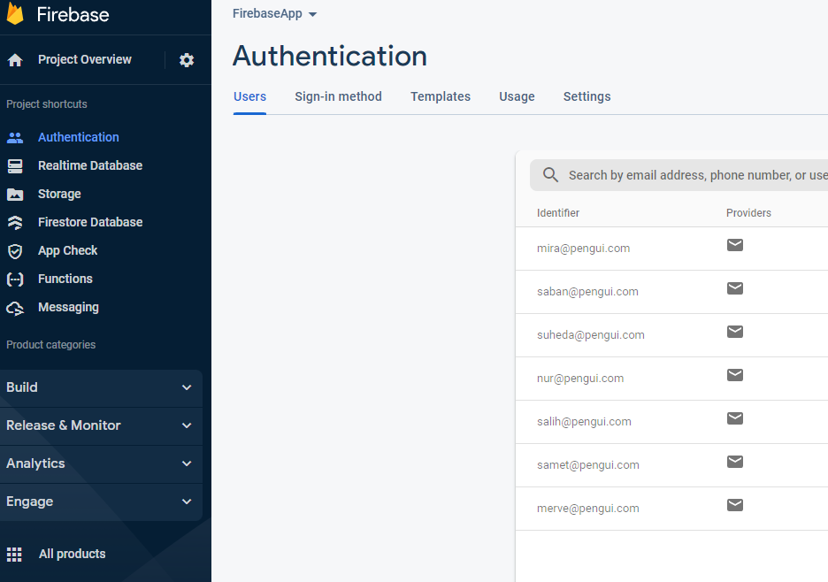
Firebase Authentication
Firebase Authentication handles logging in and identifying your users. What makes Firebase Authentication unique is that it makes it simple to perform secure logins, which are extremely difficult to implement correctly on your own. It is a service that only requires client-side code to authenticate users. Firebase Auth is compatible with social login providers such as Facebook, Google GitHub, and Twitter. If you are using android studio just one click at the firebase authentication adds all necessarry SDK’s.
Firebase Authentication and Users
NEXT

Slide 8
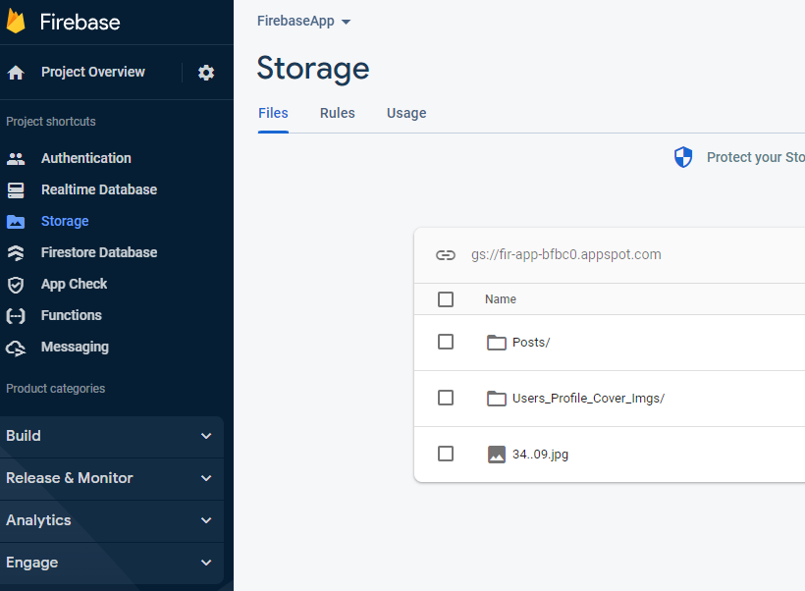
Firebase Storage
Cloud Storage is for app developers who need to store and serve user-generated content, such as photos or videos. It is actually Google's cloud storage that firebase uses it exactly as it is. The Firebase SDKs for Cloud Storage add Google security to file uploads and downloads for your Firebase apps, regardless of network quality. In addition, the developer can use it to store images, audio, video, or other user-generated content.
Firebase Storage and Folders
NEXT

Slide 9
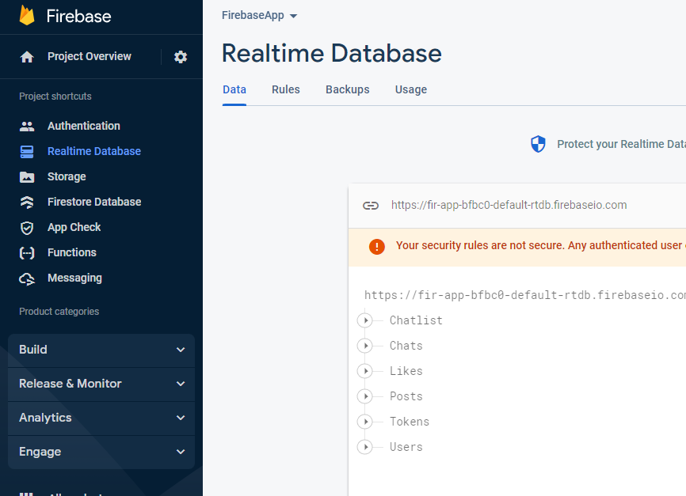
Firebase Database
Firebase offers a real-time database and a backend. The Firebase Realtime Database is a database that is hosted in the cloud. The application developer is given an API that allows application data to be synchronized among clients and stored on Firebase's cloud. Firebase's real-time database capability is extremely simple to utilize. Unstructured data can be readily added to the database once the Firebase and database requirements are introduced to the program.
Firebase Storage and Folders
NEXT

Slide 10

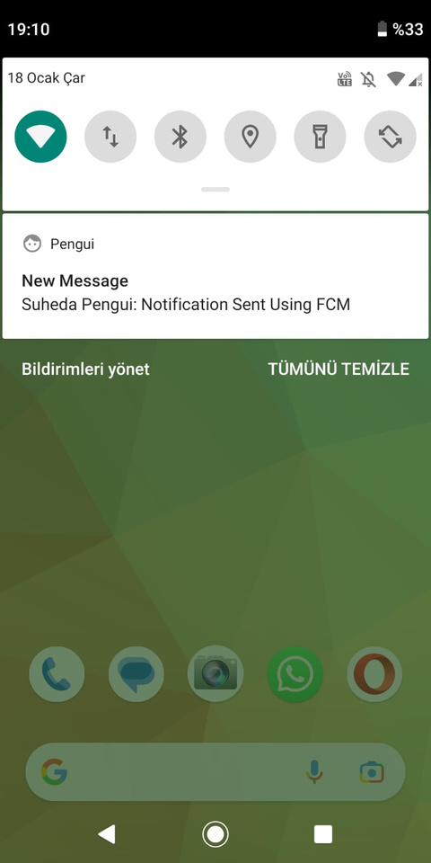
Firebase Cloud Messaging
It was previously known as Google Cloud Messaging. Firebase Cloud Messaging is designed to provide connection to your devices via messages and notifications.
"Our findings reveal that the GCM message delivery is unpredictable, namely having a reliable connection to Google's GCM servers on the client device does not guarantee a timely message arrival. Therefore, GCM is not suitable for time sensitive and/or "must-deliver-to-all" app scenarios. On the other hand, GCM delivers the push messages to a big portion of the subscribers (more than 40% in any experiment scenario) in a reasonable timeframe (in 10 seconds)." It’s intended to be reliable, with 98% of messages delivered to connected devices in 500ms or less, as well as massively scalable, with an infrastructure that delivers over a trillion messages each week.
Quotation:
Y. S. Yilmaz, B. I. Aydin and M. Demirbas, "Google cloud messaging (GCM): An evaluation," 2014 IEEE Global Communications Conference, Austin, TX, USA, 2014, pp. 2807-2812, doi: 10.1109/GLOCOM.2014.7037233.
Notifications Using Firebase Cloud Messaging
NEXT

Slide 11
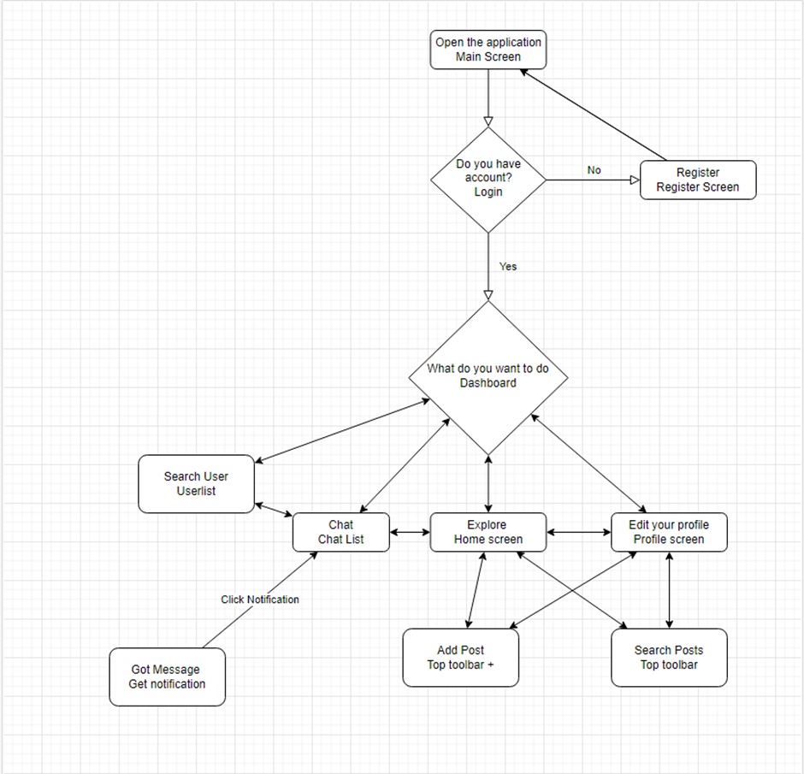
Work Flow Diagram Of The Application
Top writing is activity that gets user there
Bottom writing is the page.
NEXT

Slide 12
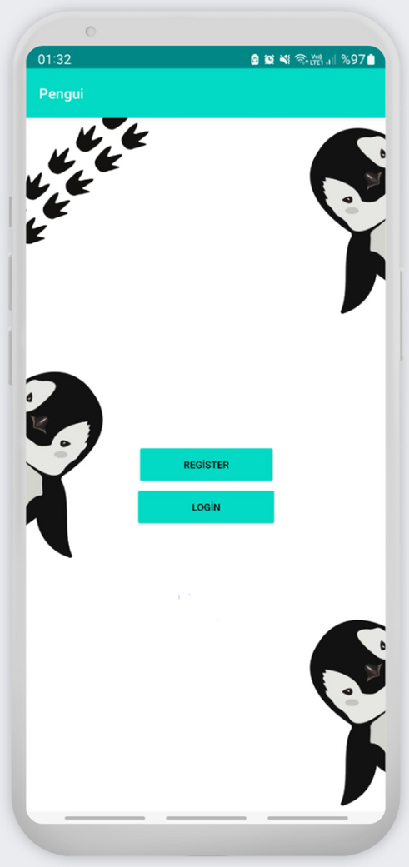
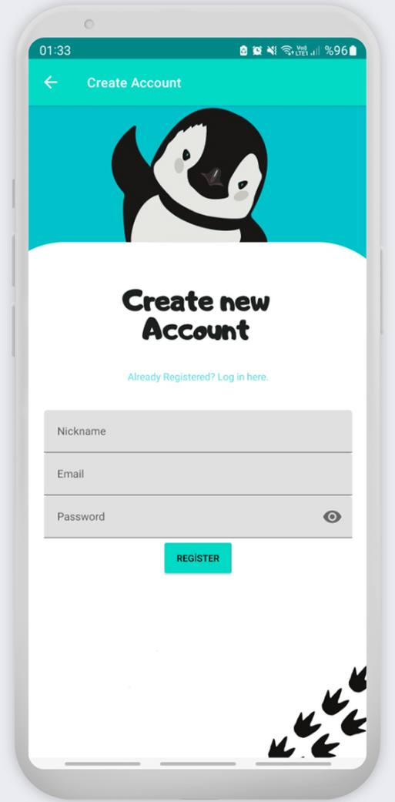
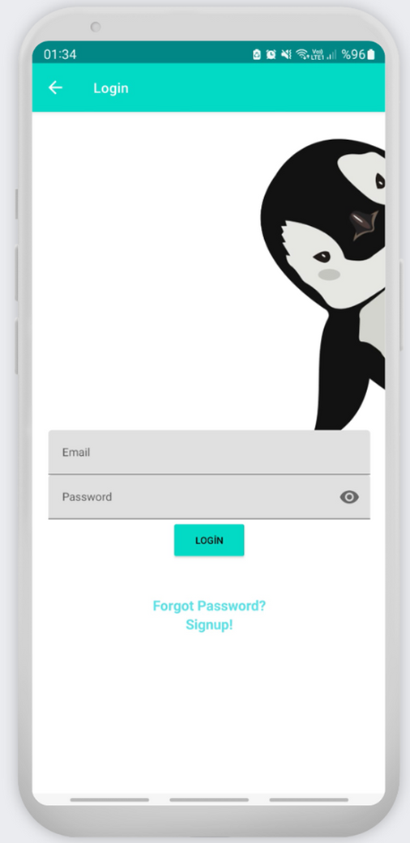
NEXT
Main Screen
Register Screen
Login Screen

Slide 13
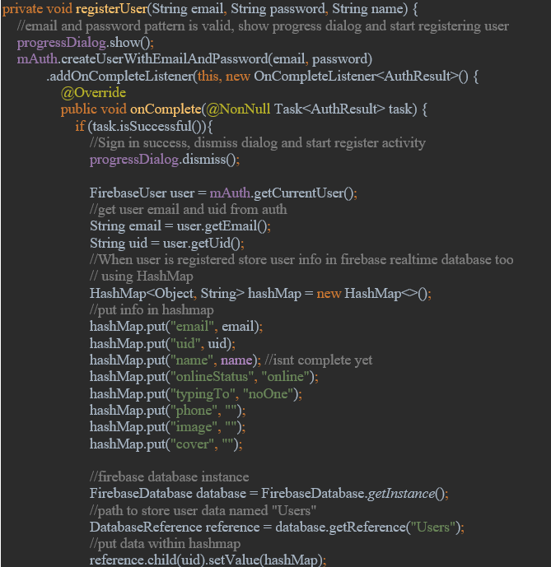
Register Page Code
As you can see there isnt any code for security measurement it just takes email password and uses Firebase Authentication for security.
NEXT

Slide 14
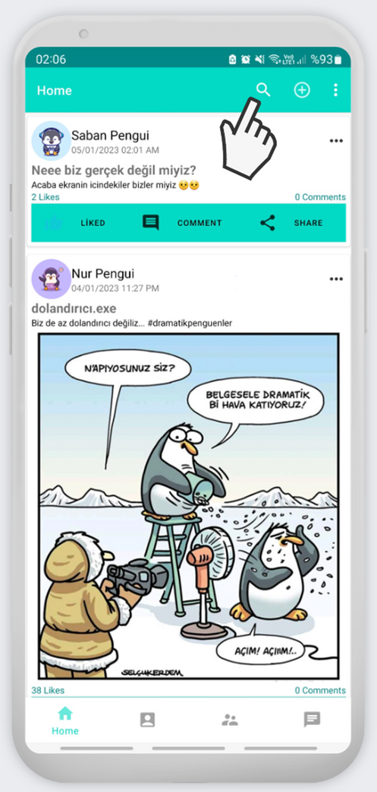
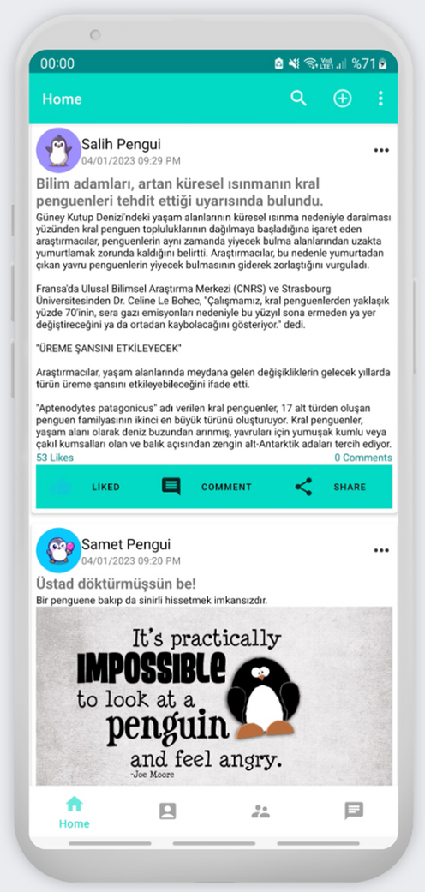
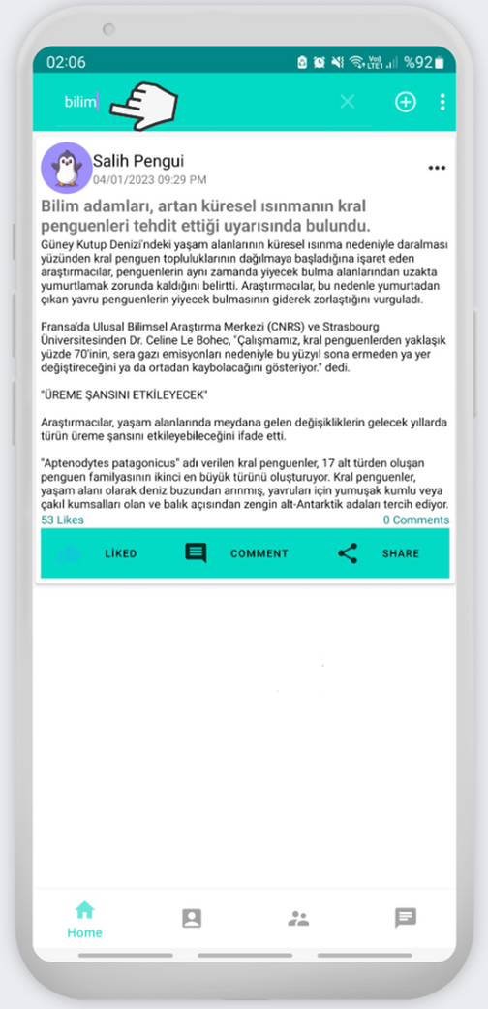
NEXT
Home Page
Home Page Search
Clicking search button open text view that user can type.

Slide 15
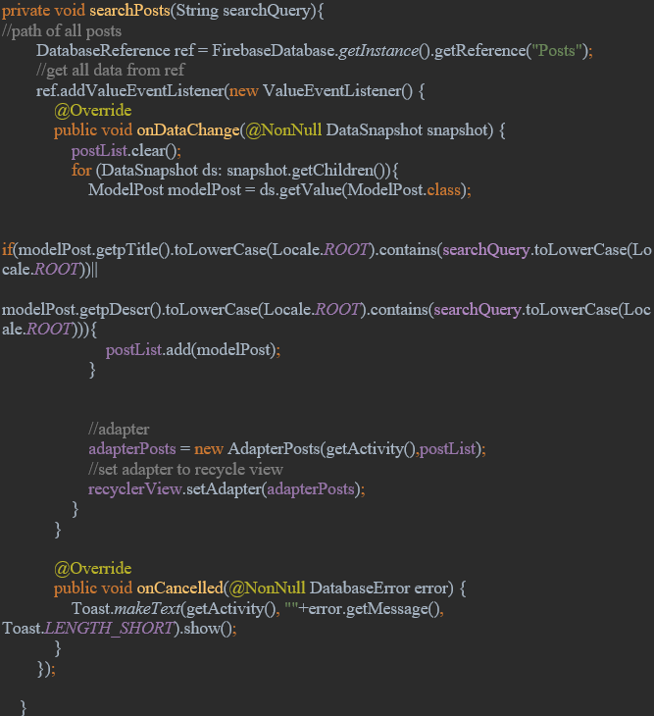
Search Post Code
It looks at Posts database and gets the post that has the searched terms.
NEXT

Slide 16
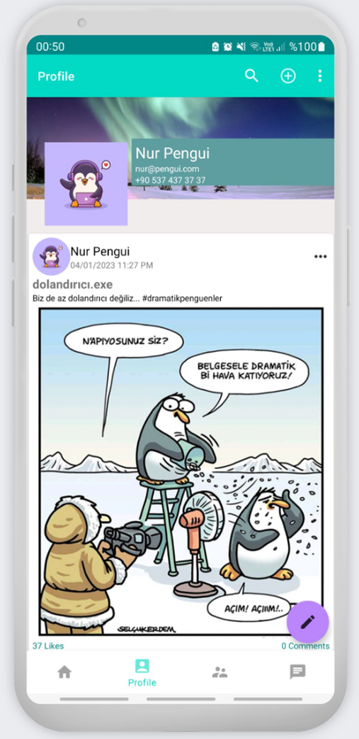
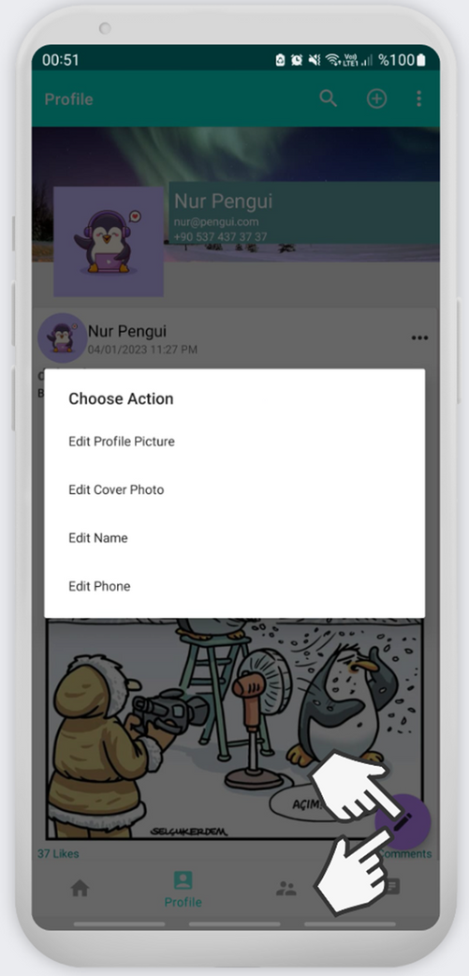
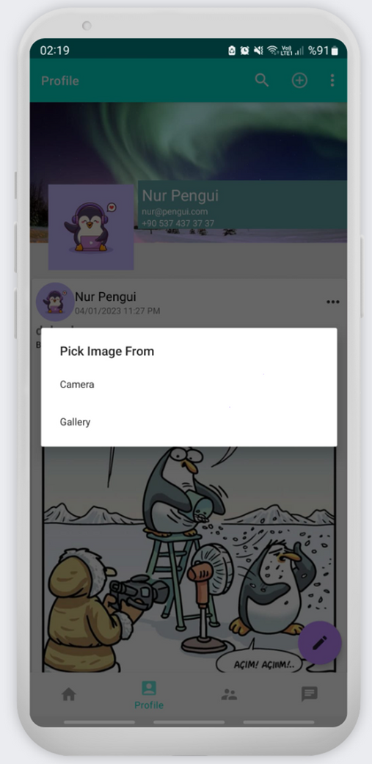
NEXT
Profile Page
Profile Page Edit
Profile Page Picture Select

Slide 17
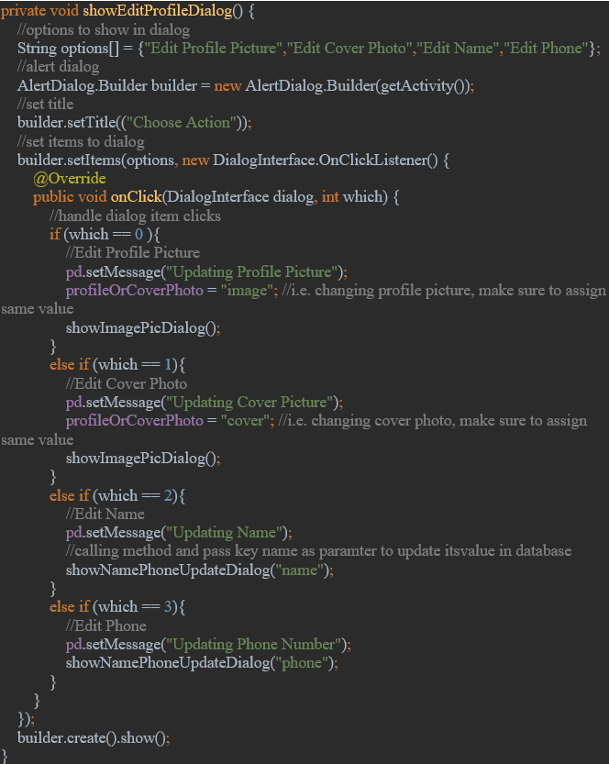
Profile Page Edit Tool Code:
It routes the choosen option the its function.
NEXT

Slide 18
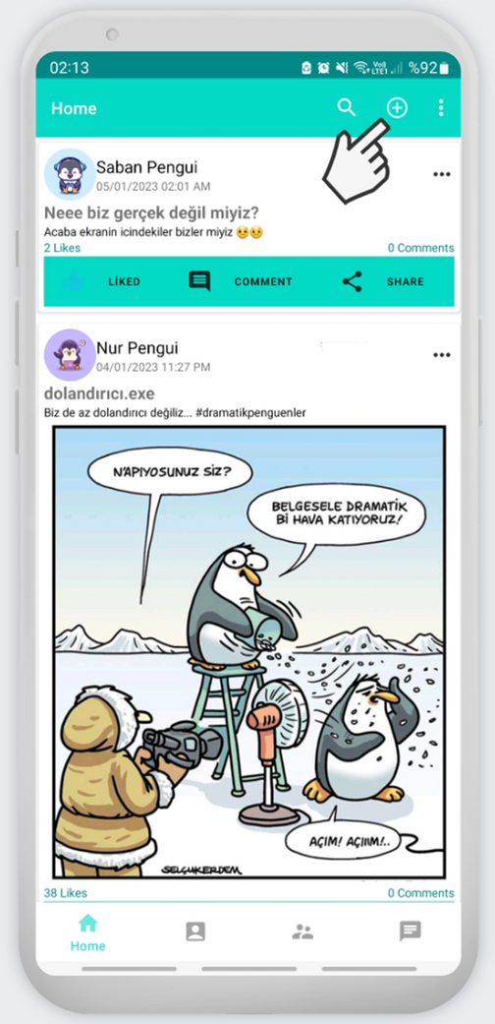
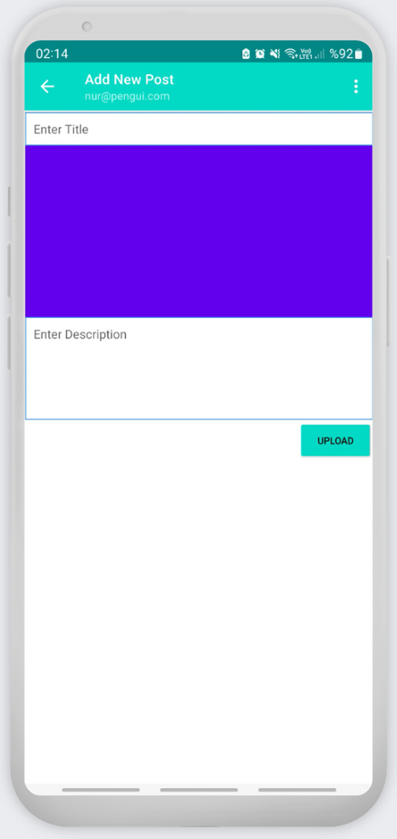
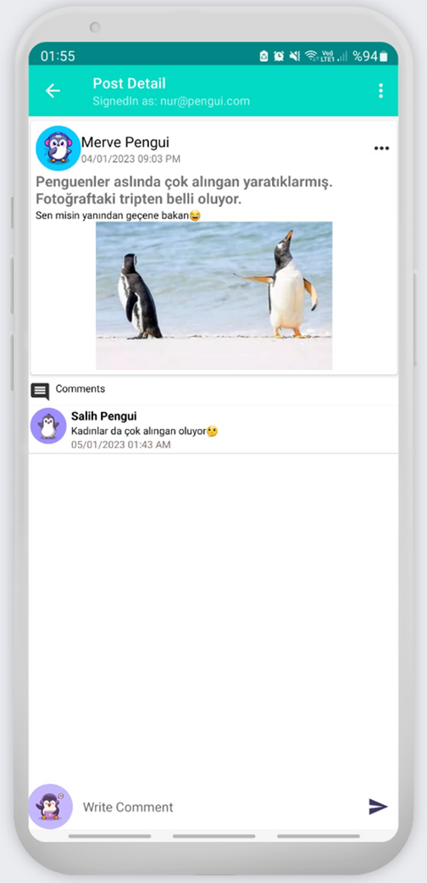
NEXT
Toolbar Menu Search, Logout,
Add Post
Add Post Page
Post Detail Page

Slide 19

Post Detail Page Loading Code
Takes id of post then searches it to get to its details on whoever posted the post and all his information then sets it in the view.
NEXT

Slide 20
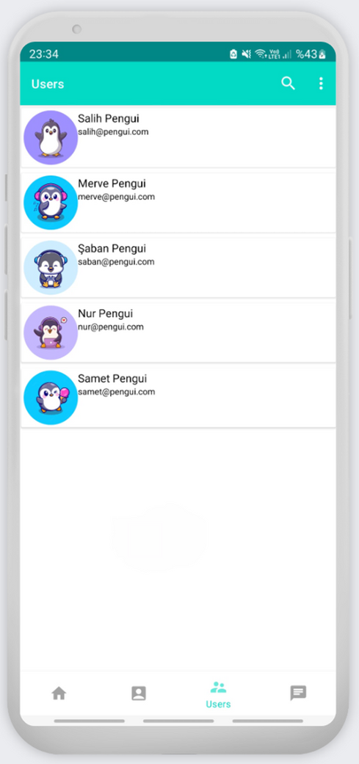
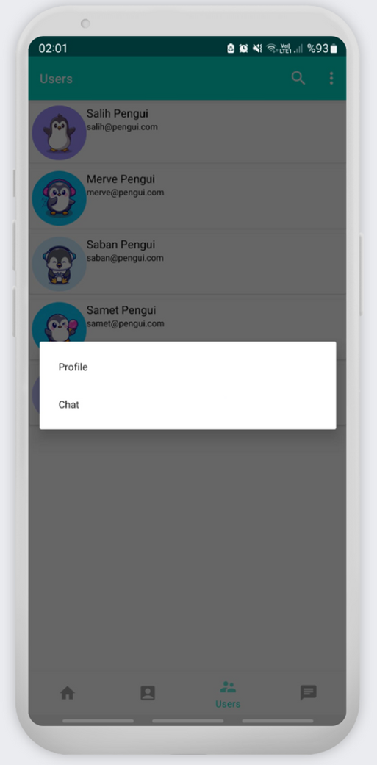
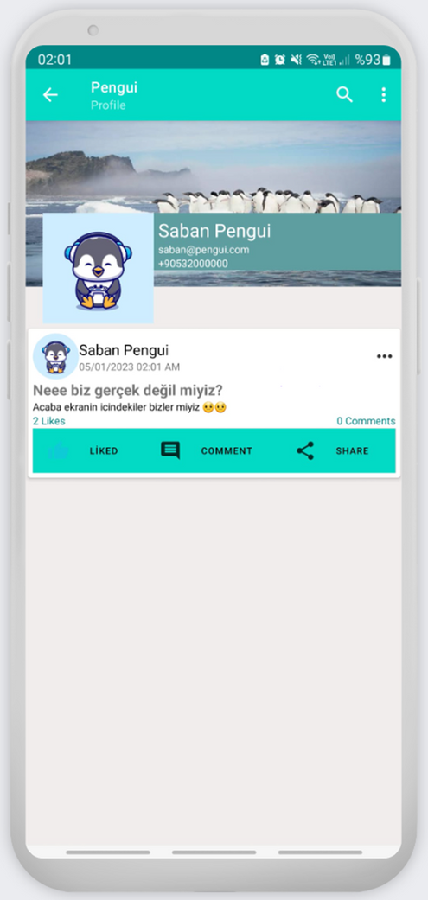
NEXT
Users Page
Users Page Interaction
Other Persons Profile

Slide 21
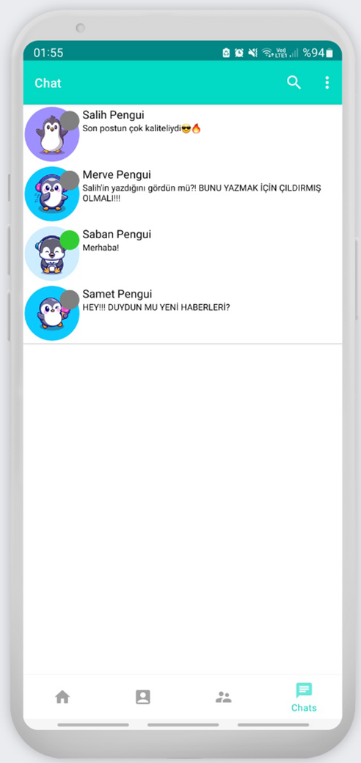
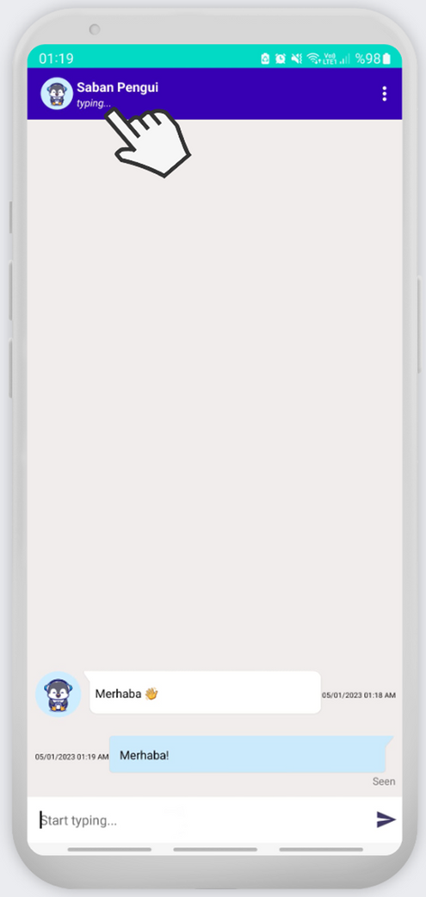
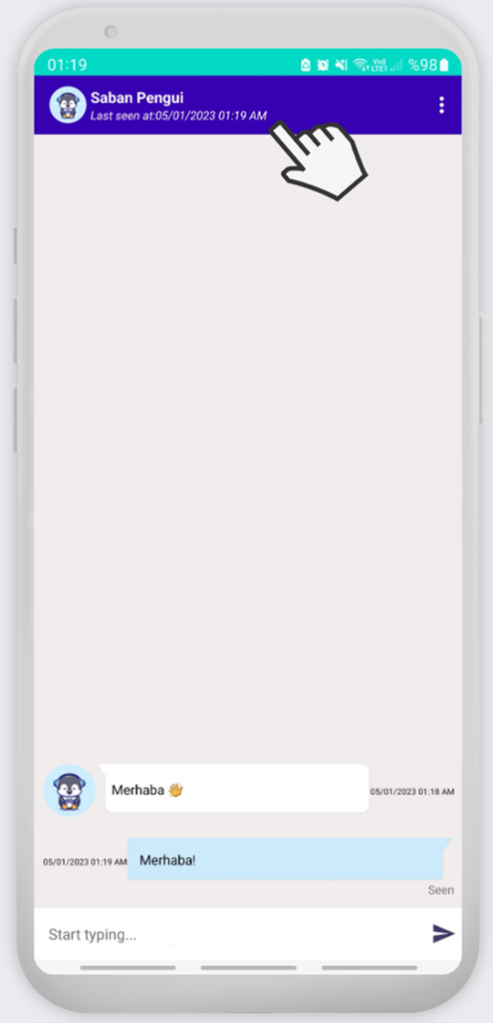
NEXT
Chats Page
Chat User Typing
Chat User Last Seen

Slide 22
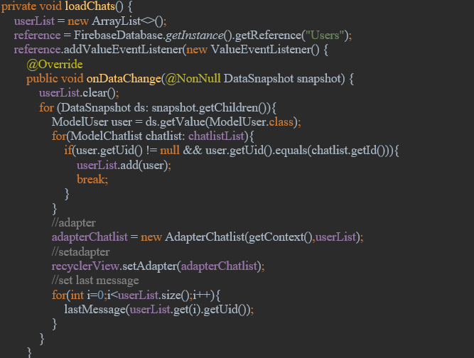
Chats Page Loading Chats Code
Searches the users own db than looks at the child database called chats to see last spoken people than loads their last message.
NEXT

Slide 23
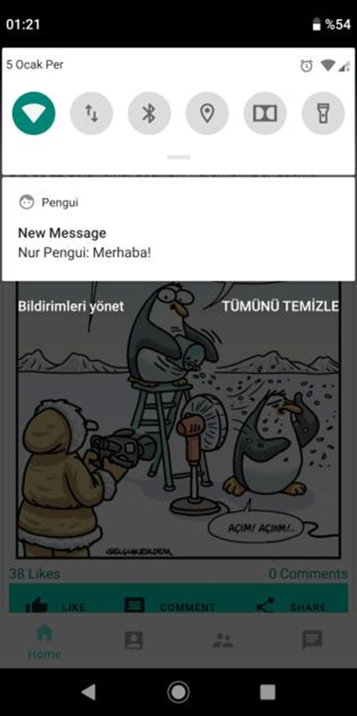
Conclusion
There isnt a fixed tool for authentication, cloud messaging, analytics, database and storage if you want to use you’ll pick the one that suits most in your case. When you want to focus on the app more instead of these tools Firebase is one of the most pickable one. I picked Firebase cause i have limited time, im working alone and i’m new to android development its my first app i wanted to focus on mostly application instead of database side. And it helped me greatly by all its services.
NEXT
Message Notifications

Slide 24

Thank you!
REFERENCES
1. Khawas, C., & Shah, P. (2018). Application of firebase in android app development-a study. International Journal of Computer Applications, 179(46), 49-53.
2. Moroney, L. (2017). An Introduction to Firebase. In The Definitive Guide to Firebase (pp. 1-24). Apress, Berkeley, CA.
3. Shukla, S., Gupta, S. C., & Mishra, P. (2021, January). Android-Based Chat Application Using Firebase. In 2021 International Conference on Computer Communication and Informatics (ICCCI) (pp. 1-4). IEEE.
4. Kumar, A. (2018). Mastering Firebase for Android Development: Build real-time, scalable, and cloud-enabled Android apps with Firebase. Packt Publishing Ltd.
5. Chatterjee, N., Chakraborty, S., Decosta, A., & Nath, A. (2018). Real-time communication application based on android using Google firebase. Int. J. Adv. Res. Comput. Sci. Manag. Stud, 6
6. https://medium.com/firebase-developers/what-is-firebase-the-complete-story-abridged-bcc730c5f2c0
FIN!

